Slide 1
PIXELATOR
Sreenidhi Institute of Science and Technology
(An autonomous institution Approved by UGC)
Yamnampet, Ghatkesar, R.R. District -501 301
Department of
COMPUTER SCIENCE & ENGINEERING
GROUP PROJECT DESIGN SEMINAR
on
Submitted By
Batch No. A14
Bharath Ramagoni 12311A0511
Aswini Kumar Ala 12311A0526
B. Goutham Reddy 12311A0543
Head of the Department : Project Coordinator : Internal Guide :
Mrs.Prof. Aruna Varanasi Mrs.T.Mamatha Mrs. G. Kalyani

Slide 2
ABSTRACT
PIXELATOR is a user friendly computer application that can be used to manipulate and apply edits on to images such as Rotating an Image, Resizing an image, Adding Text to an Image, Making an Image’s Background transparent, Changing the brightness of an Image etc.

Slide 3
MODULES
File Manipulation
Opening Images
Saving the Image
Saving the Image as a Different File
Image Editing
Changing the Dimensions of the Image
Rotating the Image
Adding Text to the Image
Changing the Brightness of the Image
Making the Background Transparent

Slide 4
File Manipulation
This Module is related to the manipulation of files done by the PIXELATOR application.
To Edit an Image, the user has to open it.
After Editing, the user has to save the image for further use.
All these actions deal with the file system of the Computer.

Slide 5
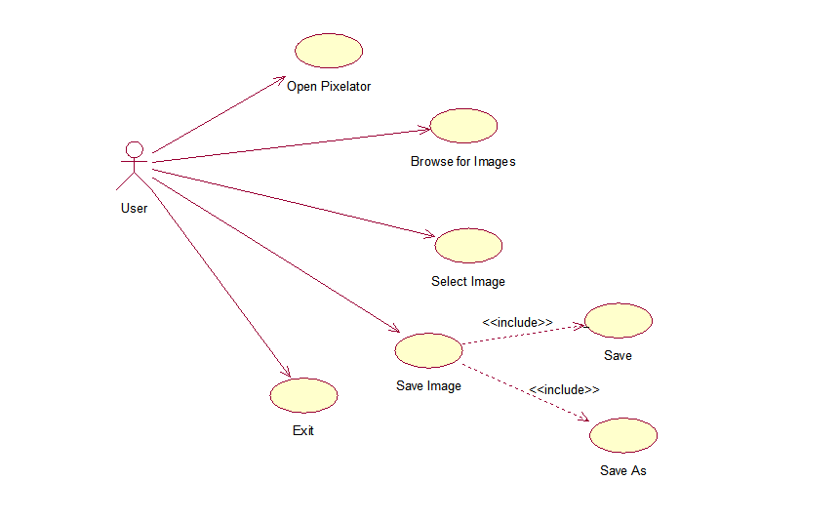
Use Case Diagram for File Manipulation

Slide 6
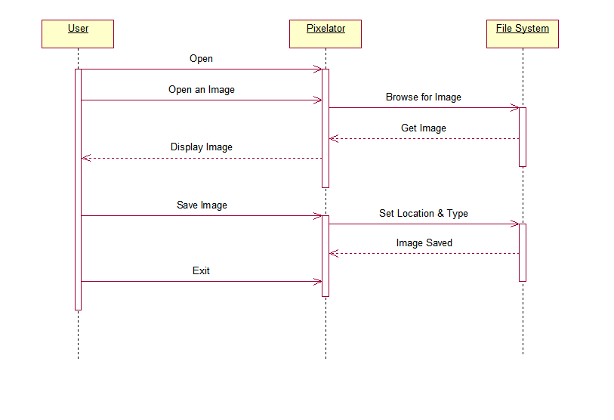
Sequence Diagram for File Manipulation

Slide 7
Image Editing
This Module is related to the actual intention of the Application.
The User can do the following changes to an image:
Adding Text to an Image
Rotating the Image
Changing the Brightness of an Image
Making the Background of an Image transparent
Resizing the Image
Compressing the Image
Cancelling any previous editing done

Slide 8
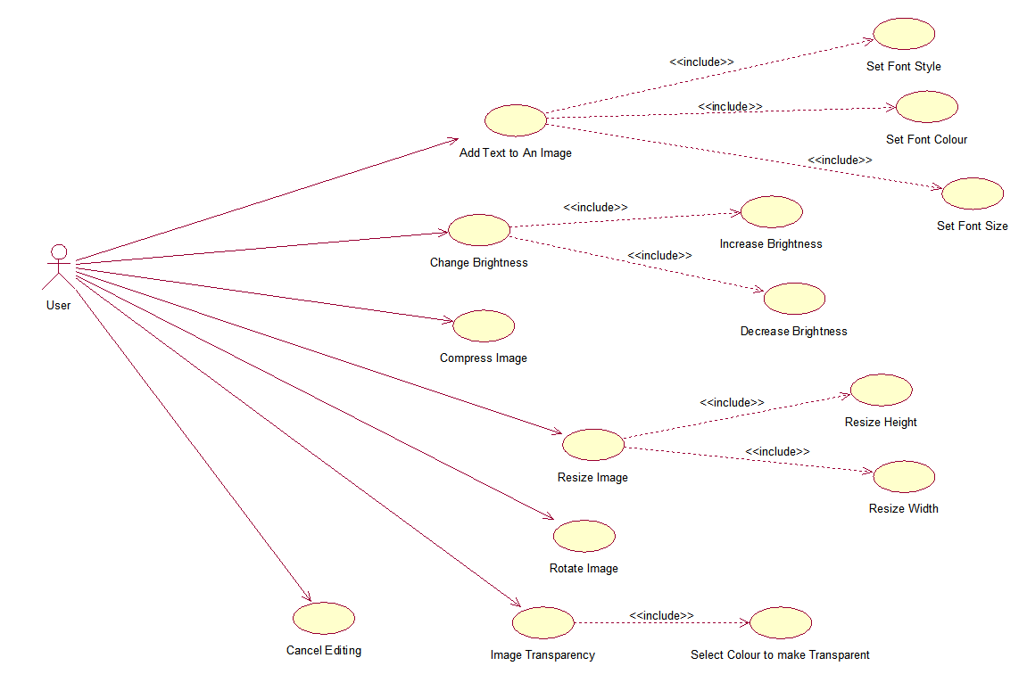
Use Case Diagram for Image Editing

Slide 9
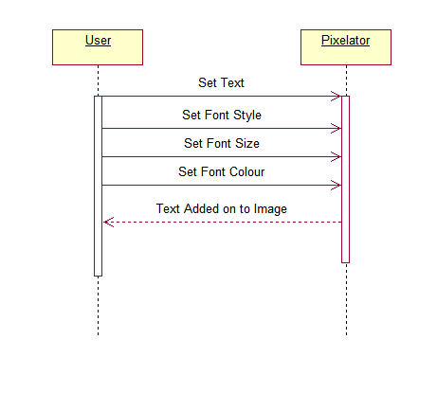
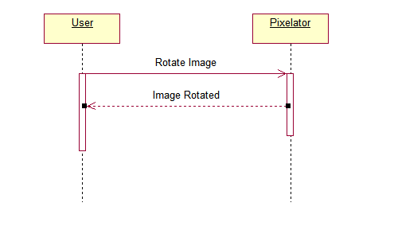
Sequence Diagrams for Image Editing
Rotating an Image
Adding Text to an Image

Slide 10
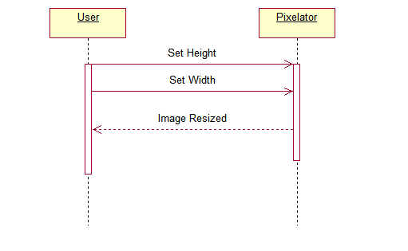
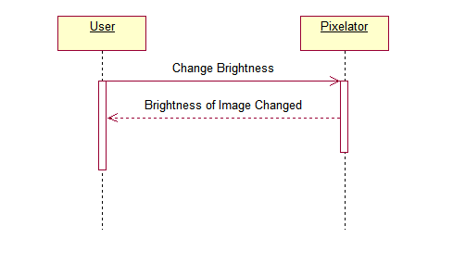
Sequence Diagrams for Image Editing
Resizing an Image
Changing the Brightness of an Image

Slide 11
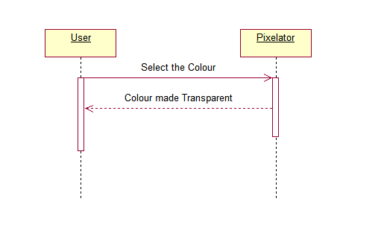
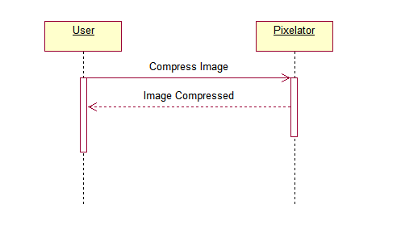
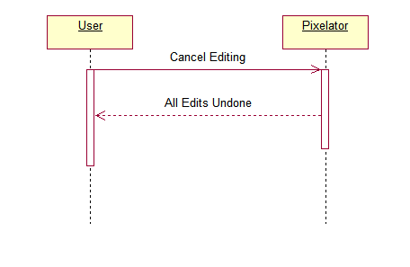
Sequence Diagrams for Image Editing
Compressing an Image
Making a colour of an Image Transparent
Cancelling the Edits done

Slide 12
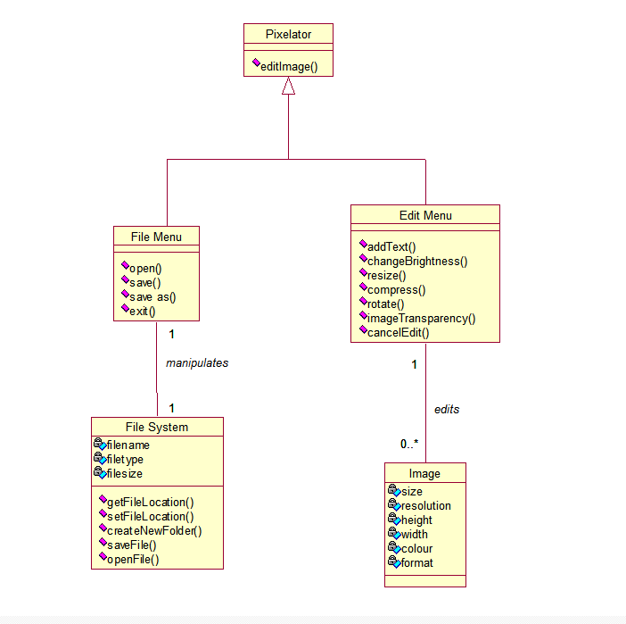
Class Diagram for PIXELATOR

Slide 13
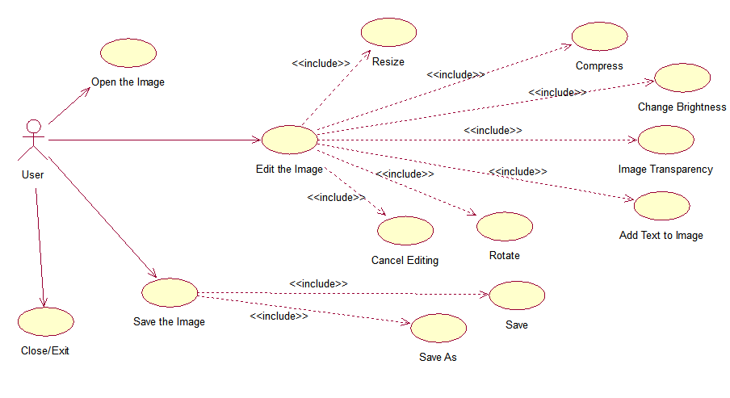
Use Case Diagram for PIXELATOR

Slide 14
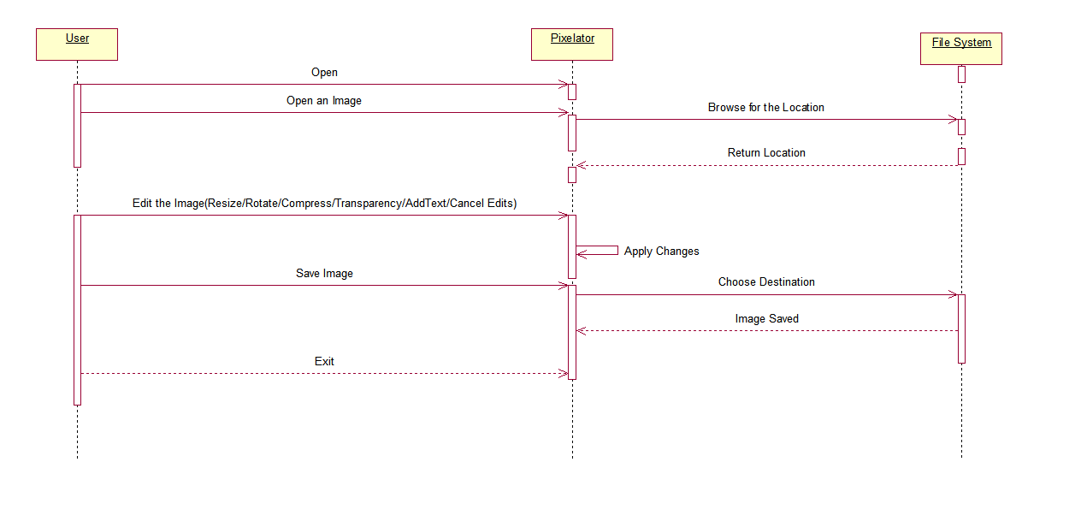
Sequence Diagram for PIXELATOR

Slide 15
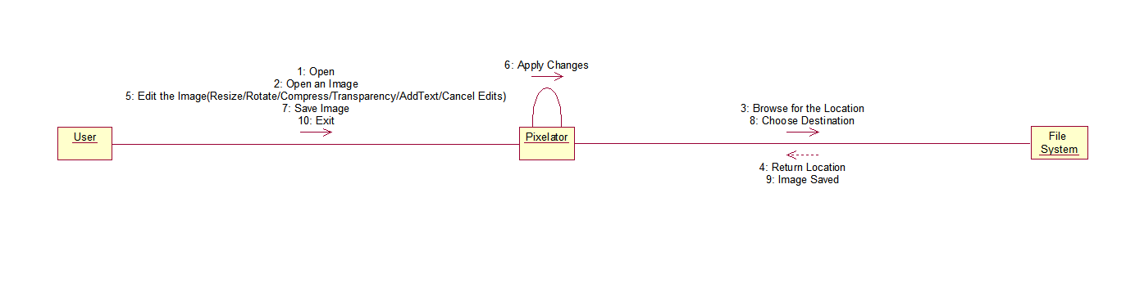
Collaboration Diagram for PIXELATOR

Slide 16
THANK YOU!

